Slide 1



Bank Database Management System
PRESENTED BY RIYAZ ANSARI

Slide 2
Aim of project
To design and implement a relational database for a bank using MySQL, with the objective to efficiently manage customer details, account info, and banking operations. The project was aimed at learning database design and mastering core SQL concepts.

Slide 3
introduction
The Bank Database Management System is a practical project designed to simulate real-world banking operations through a structured relational database. Using MySQL, this system manages essential data such as customer details, account information, bank branches, and customer references.
The project helps in understanding how databases store, retrieve, and relate complex information efficiently. It also strengthens skills in SQL queries, table relationships, and data integrity.
This system is a foundation for developing more advanced banking applications and showcases the use of SQL for managing financial data securely and effectively.

Slide 4
Tables in project
Bank info
Account info
Customer personal info
Customer reference

Slide 5
Description Of Tables

Slide 6
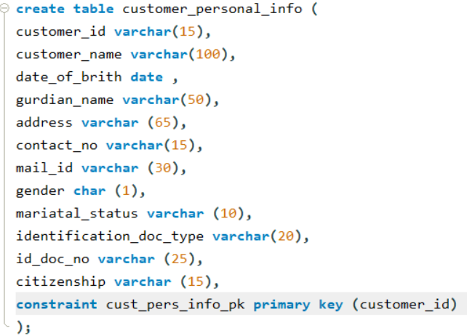
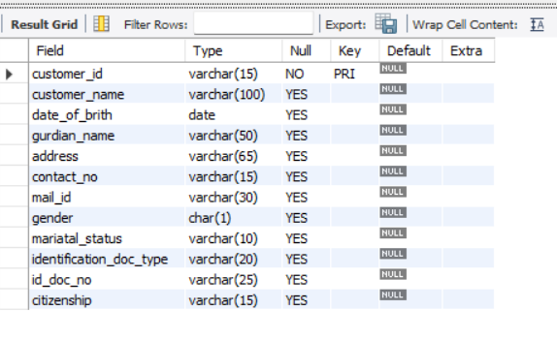
Customer personal info

Slide 7
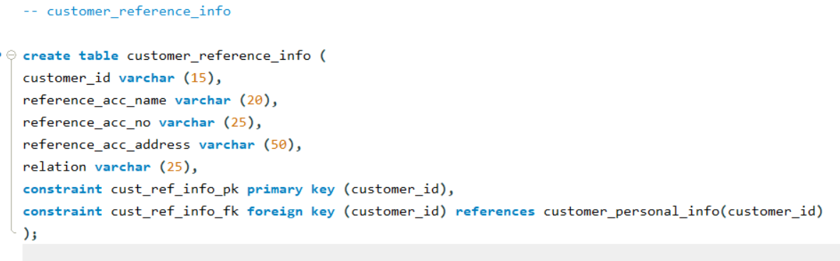
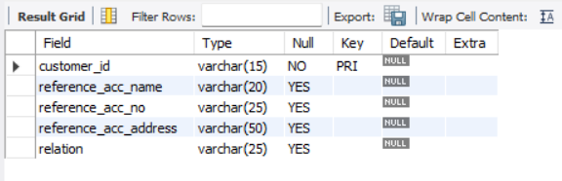
Customer reference

Slide 8
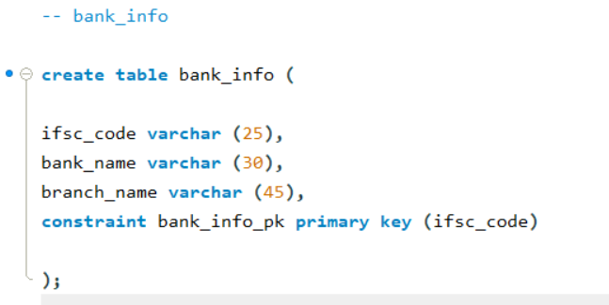
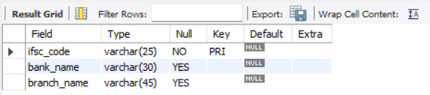
Bank info

Slide 9
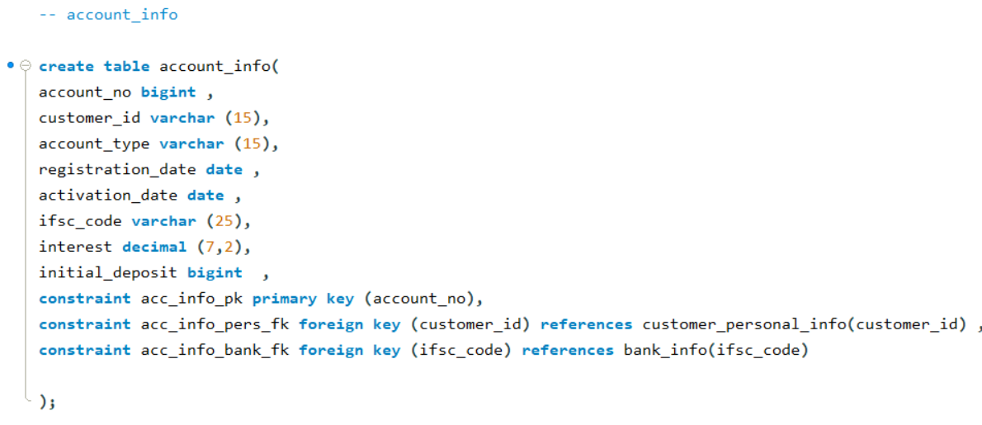
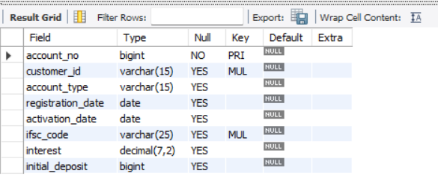
Account info

Slide 10
Inserting values

Slide 11
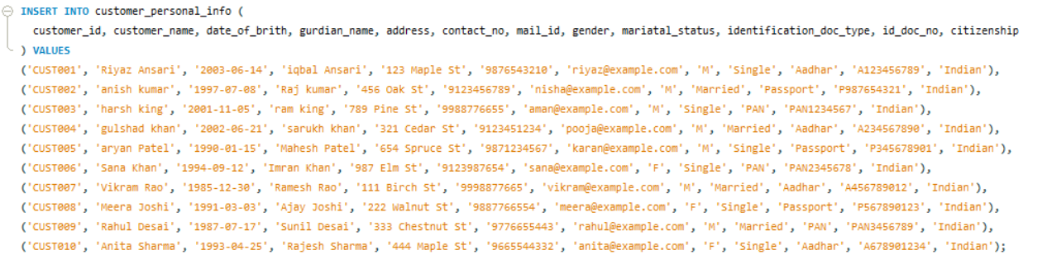
Customer personal info

Slide 12
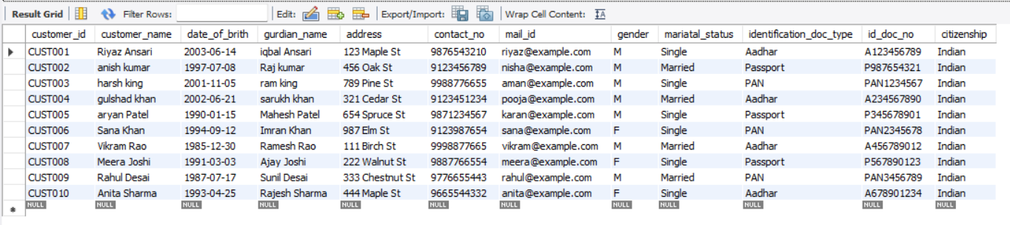
Select * from Customer personal info

Slide 13
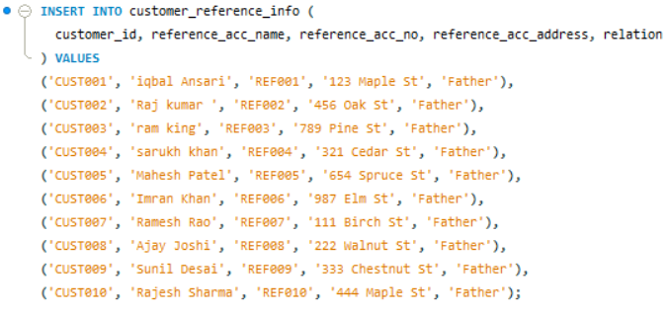
Customer reference

Slide 14
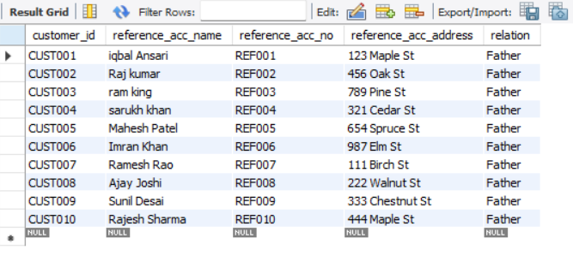
Select * from Customer reference

Slide 15
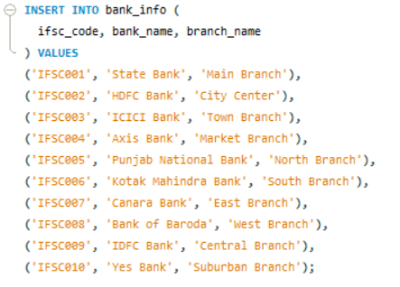
Bank info

Slide 16
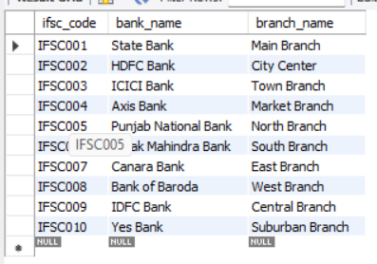
Select * from Bank info

Slide 17
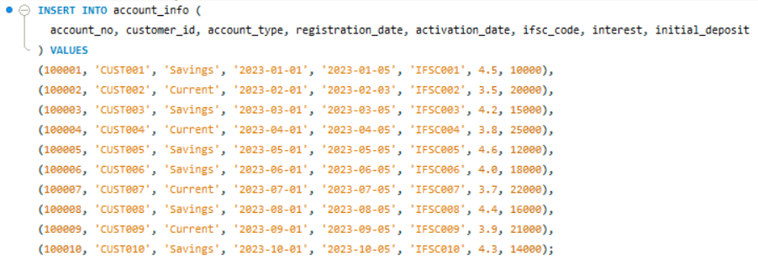
Account info

Slide 18
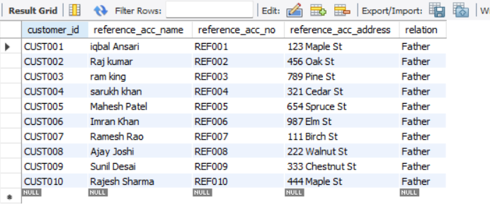
Select * from Account info

Slide 19
D m l operations on table

Slide 20
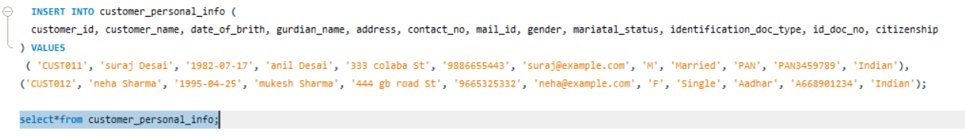
insert
In MySQL, the INSERT statement is used to add new rows of data to a table.
Using INSERT, Inserting some customer_ personal_ifno table.

Slide 21

update
The UPDATE statement in MySQL is used to modify existing records in a table.
Using Update, Update the deposit of account_no 100007 ‘ 25000/

Slide 22

delete
In MySQL, DELETE is a statement used to remove rows from a table based on a specified condition.
Using Delete, delete the whole row where account_no is 100003.

Slide 23
Ddl operations

Slide 24
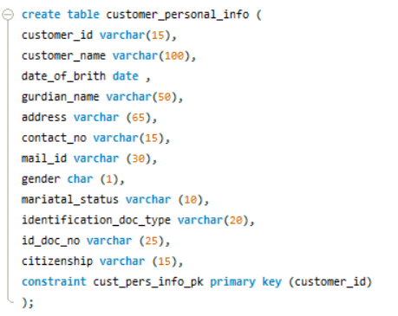
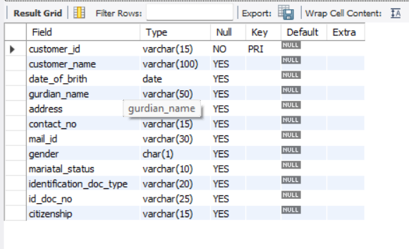
create
In MySQL, the CREATE statement is used to create a new database, table, index, or other objects.
Using Create, created table name customer_personal_info

Slide 25
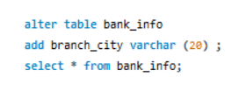
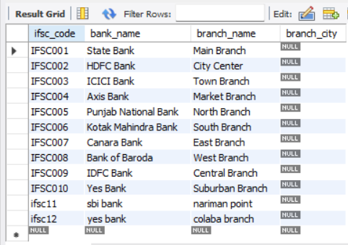
alter
In MySQL, the ALTER statement is used to modify an existing database table.
Using Alter, created new column name branch-city .

Slide 26

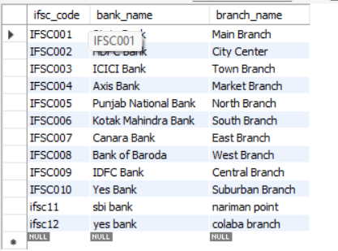
drop
In MySQL, DROP is a SQL command used to delete a database, table, index, or other objects permanently.
Using Drop, droped table named branch-info from database.

Slide 27

truncate
In MySQL, TRUNCATE is a Data Definition Language (DDL) command used to quickly delete all rows from a table, resetting the auto-increment counter, if any.
Using Truncate, truncate table named customer- reference from database.

Slide 28
Dql operations

Slide 29

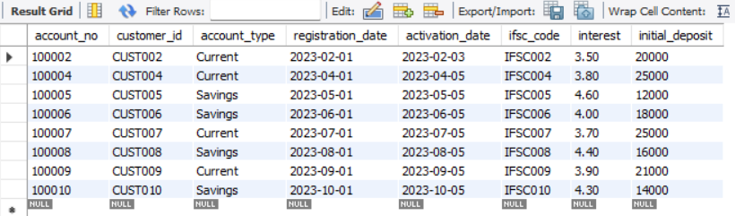
select
The SELECT statement in MySQL is used to query and retrieve data from one or more tables in a database
Using Select, Retrieving all properties details whose status is sold.

Slide 30
Question and Answer

Slide 31
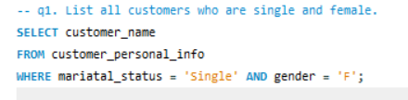
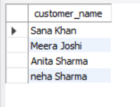
1. List all customers who are single and female.

Slide 32
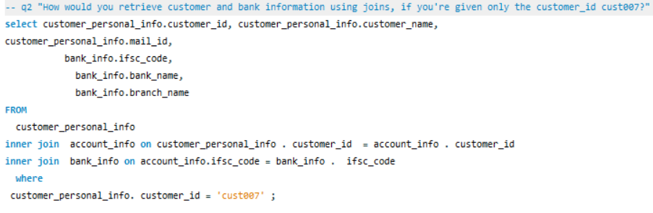

2. how would you retrieve customer and bank information using join ,if you re given only the customer_id cust007 ?

Slide 33
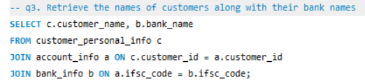
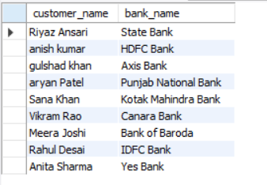
3. Retrieve the names of customers along with their bank names.

Slide 34
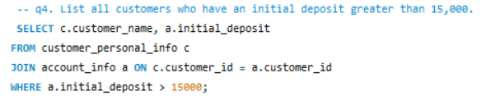
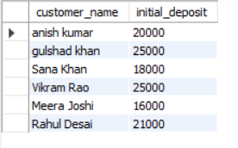
4. List all customers who have an initial deposit greater than 15,000.

Slide 35
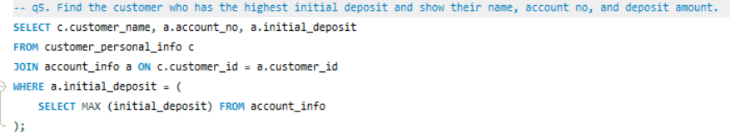

5. find the customer who has the highest initial deposit and show their name, account no , and deposit amount .

Slide 36

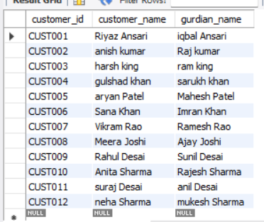
6. Display the customer ID, name, and their guardian's name for all customers.

Slide 37
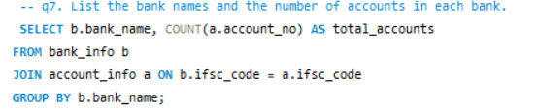
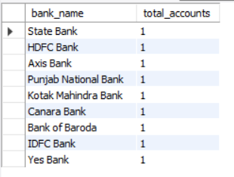
7. List the bank names and the number of accounts in each bank.

Slide 38
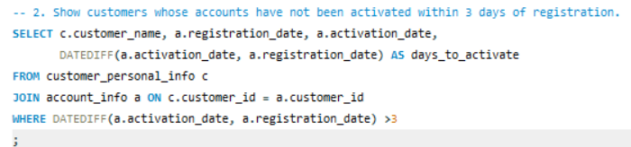
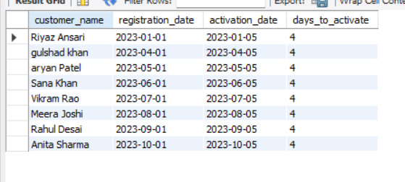
8. Show customers whose accounts have not been activated within 3 days of registration.

Slide 39
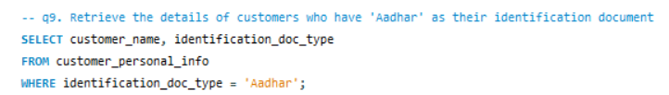
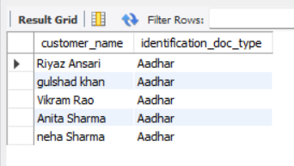
9. Retrieve the details of customers who have 'Aadhar' as their identification document.

Slide 40
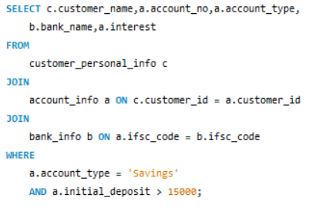
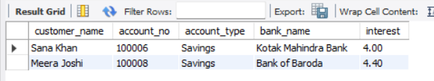
10. Show the customer name, account number, account type, bank name, and interest rate for all customers who have a 'Savings' account and deposited more than 15,000

Slide 41
Thank you Note: All the questions used in this project were provided with the help of ChatGPT, and a few were given by a person who has 3 years of experience in the data analytics field.

